Slide 1
Static Time Analysis
Ahmed Refaay – 900141806
Lotfy Abdel Khaliq – 900143801
Noor Abdel Hamid - 900143227
Yahia Sherif - 900141148

Slide 2
Objectives
1- Create a tool to calculate the delays in all timing paths and report slacks.
2- Generate timing reports.

Slide 3
Steps & Work Division
Parasitic delays and Slews from SPEF
Liberty File and Calculating the delays and output transitions
Blif parser
.V & DAG creation
Creating and Analysing a small Example to test our work using Lab2 and Lab3
Creating another Example that contains Sequential Elements
Forward and Backward propagation to calculate AAT & RAT

Slide 4
SPEF
Standard Parasitic Exchange Format (SPEF) is an IEEE standard for representing parasitic data of wires in a chip in ASCII format, and is fed to STA tool to do post layout Static Timing Analysis.

Slide 5
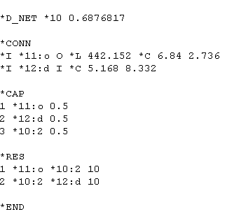
Nets
The net in spef contains 3 main parts.
Connections (*CONN)
Capacitance (*CAP)
Resistance (*RES)

Slide 6
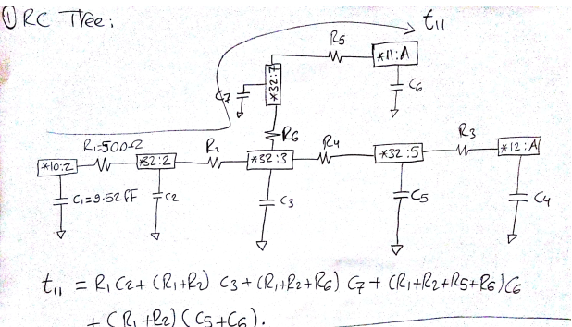
Graph
We create a Graph, with Nodes from the (*CAP section) and Edges from the (*RES section).

Slide 7
SPEF File Calculations
Get delay function
A function get_delay() is called to get the calculate the delay of each branch using Elmore delay.
Input
Output
The function puts all the delays of each branch in the vector out_branches. This output will be fed to our DAG.

Slide 8


Continue of Calculations
Get slew
The value of the output slew (so) on any given tap node T can be approximated by a two-step process. First, we compute the output slew of the impulse response on T, which is approximated by
Inputs
Output
The function puts all the delays of each branch in the vector out_branches_slew. This output will be fed to our DAG

Slide 9
Lib File
Cell-based delay calculation is modeled by characterizing cell delay and output transition time (output slew) as a function of input transition time (input slew) and the capacitive load on the output of the cell.

Slide 10
Lib File Calculations
Calc function calculates the delay and slew
Early and late file models.
Rise and Fall

Slide 11
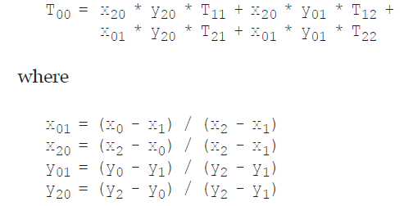
Interpolation
It is used to calculate the correct delay or slew from the timing arc.

Slide 12
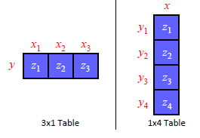
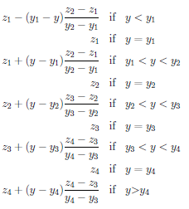
Extrapolation
Extrapolation is a special case of the interpolation.
Uses 1 dimensional

Slide 13
Blif File
The goal of BLIF is to describe a logic-level hierarchical circuit in textual form. A circuit is an arbitrary combinational or sequential network of logic functions.

Slide 14
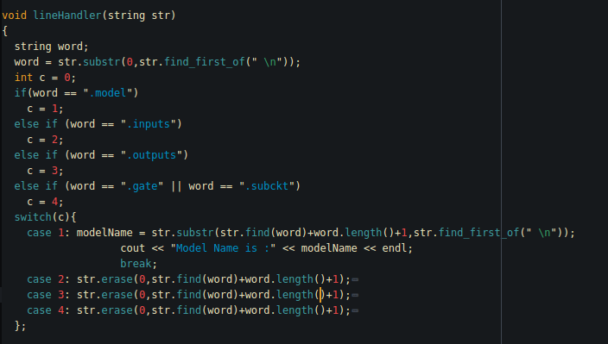
Objective from Blif
To get the information about the gate level netlist and the connection among nodes which are representing inputs, outputs, wires. Therefore, we would be able to generate the Graph

Slide 15
.V parser & DAG Creator
Difference between the V file and Blif.
Objectives of V file
Extract instance name for the SPEF to identify the delays
Pre-defines wire names

Slide 16
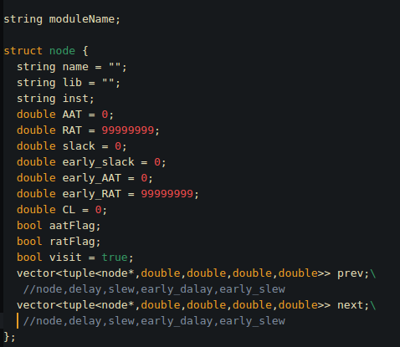
Node Structure
The node struct contains information about each pin in the DAG and is connected to other nodes through a vector of next and previous nodes. In addition, every next/previous node is saved along with four information's (late delay-late slew- early delay- early slew) in a tuple that represents the edge between two nodes.

Slide 17
Algorithm of DAG Creator
Create all input/output/wire nodes
Save each primary node into a map
Loop over the cells
Each pin in a cell is connected to a previous primary node so create a new node for cell pin and associate an edge between the two nodes
Check For inputs/outputs pin of the gate to create edges with the internal gate nodes
Update the connections
- Call Function SetupWireDelay to set up delays between external nodes (wire delay)
- Same with SetupWireSlew for the wires

Slide 18
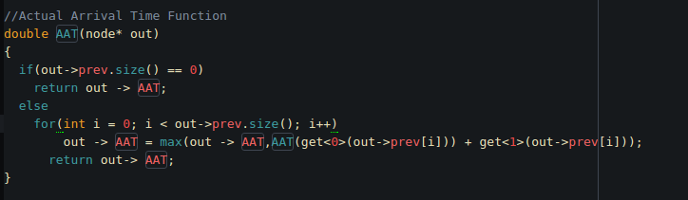
AAT & RAT

Slide 19
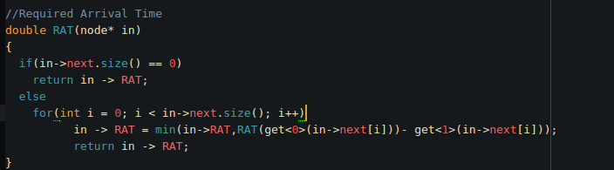
AAT & RAT (2)

Slide 20
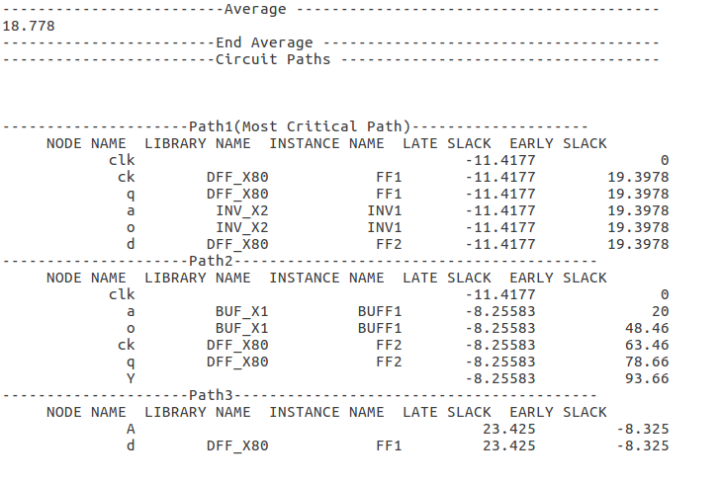
Timing Report

Slide 21
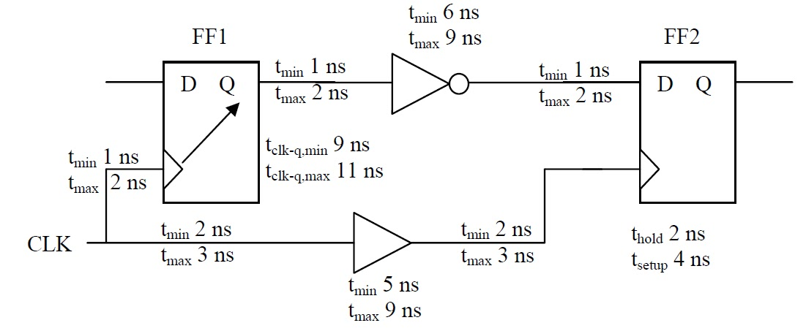
Test Case

Slide 22
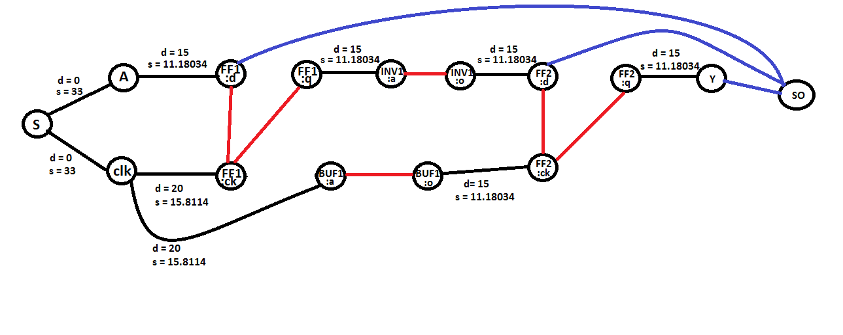
DAG

Slide 23
Thank you

